Slide 1

Precision Agriculture For Better Irrigation Using IOT and Deep Learning
4rth Semester
MID SEM
Under the supervision of
Dr. Priyanka Rathee
Presented by
AKHIL SINGH SANORIA
23MCS106

Slide 2
Precision Agriculture For Better Irrigation Using IOT and Deep Learning

Slide 3
Table of Contents
01
02
04
03
Introduction
Literature review
To introduce the concept of precision agriculture
Overview of relevant research papers
Proposed models
Objectives
05
Objective of the problem statement

Slide 4
01
INTRODUCTION
Introduction to the concept of precision agriculture

Slide 5
Introduction to Precision Agriculture
What is precision agriculture:
Precision agriculture uses technology like sensors, GPS, and data analytics to optimize crop yield.
Key technologies precision agriculture uses:
IOT
Drones & Remote Sensing
Machine learning and deep learning .

Slide 6
Introduction to Precision Agriculture
Water Scarcity
Global water scarcity and agriculture precession reduce agricultural water waste.
Precision Agriculture: A Solution to Water Wastage in Agriculture
Smart irrigation system
Drones and Remote sensing
Predictive Analytics for Water Management

Slide 7
02
Literature Review

Slide 8
Literature review
Sno. | Author name | journal | Year | Title | Summary
1. | Youness Tacea Mohamed Tabaac Sanaa Elfilali | Energy Reports(Elsevier) | 05, May 2024. | Smart Irrigation System Based on IOT and Machine Learning. | Review paper which include machine learning like KNN ,SVM etc for the smart irrigation
2. | Nilay Ganatra Atul Patel | Machine Learning for Predictive Analysis: Proceedings of ICTIS (Springer) | 2023 | Deep Learning Methods and Applications for Precision Agriculture | Provides a detailed survey of deep learning applications in precision agriculture, emphasizing methods like CNNs and RNNs

Slide 9
Literature review
Sno. | Author name | journal | Year | Title | Summary
3. | Pankaj Kumar Kashyap Sushil Kumar Ankita Jaiswal Mukesh Prasad Amir H. Gandomi. | IEEE Sensors Journal (IEEE) | 2021 | Towards Precision Agriculture: IoT-Enabled Intelligent Irrigation Systems Using Deep Learning Neural Network | Perform deep learning approach which is LSTM and focus on predicting soil moisture for the better irrigation of the water in the farming .

Slide 10
Literature Review
Sno. | Author name | Journal | Year | Title | Summary
4. | Yu Jingxin Zhang Xin Xu Linlin Dong Jing Zhangzhong Lili. | Agricultural Water Management (Elsevier) | 2021 | A hybrid CNN-GRU model for predicting soil moisture in maize root zone. | This research proposes a hybrid model combining Convolutional Neural Networks (CNN) and Gated Recurrent Units (GRU) to predict soil moisture .

Slide 11
03
Problem Statement

Slide 12
Research Gaps
Earlier model trained on 1 year of dataset but we have organized 6 years of data.
Limitations of using LSTM for long-term prediction (vanishing gradient).
No better method adaptive threshold-based control for efficient water irrigation.

Slide 13
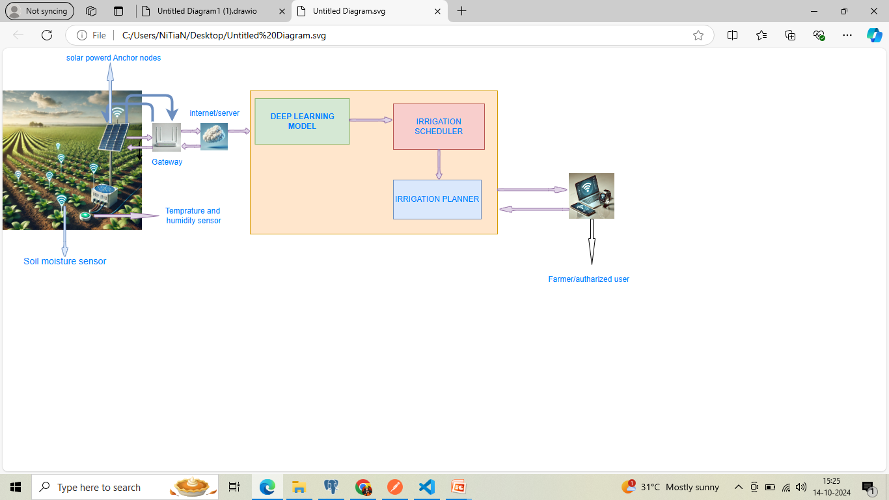
Precision agriculture for Irrigation with use of Deep Learning and IOT
Fig 3.1

Slide 14
Objectives
To design deep learning model and IOT based smart irrigation water to predict soil moisture .
The objective is to develop an irrigation scheduling model that generates optimized irrigation schedules and accurately estimates the water quantity required for the farmland.
Proposed model is conducted using python base libraries .

Slide 15
Proposed Models
Transformer model
LSTM with attention model
LSTM with MAML model

Slide 16
Model 1 – Transformer-Based Model
Model 1 – Transformer-Based Model
Overview:Uses positional encoding and self-attention mechanisms to handle long sequences effectively.
Advantages:Captures long-range dependencies without vanishing gradient issues.
Limitations:High computational cost and sensitivity to data volume.

Slide 17
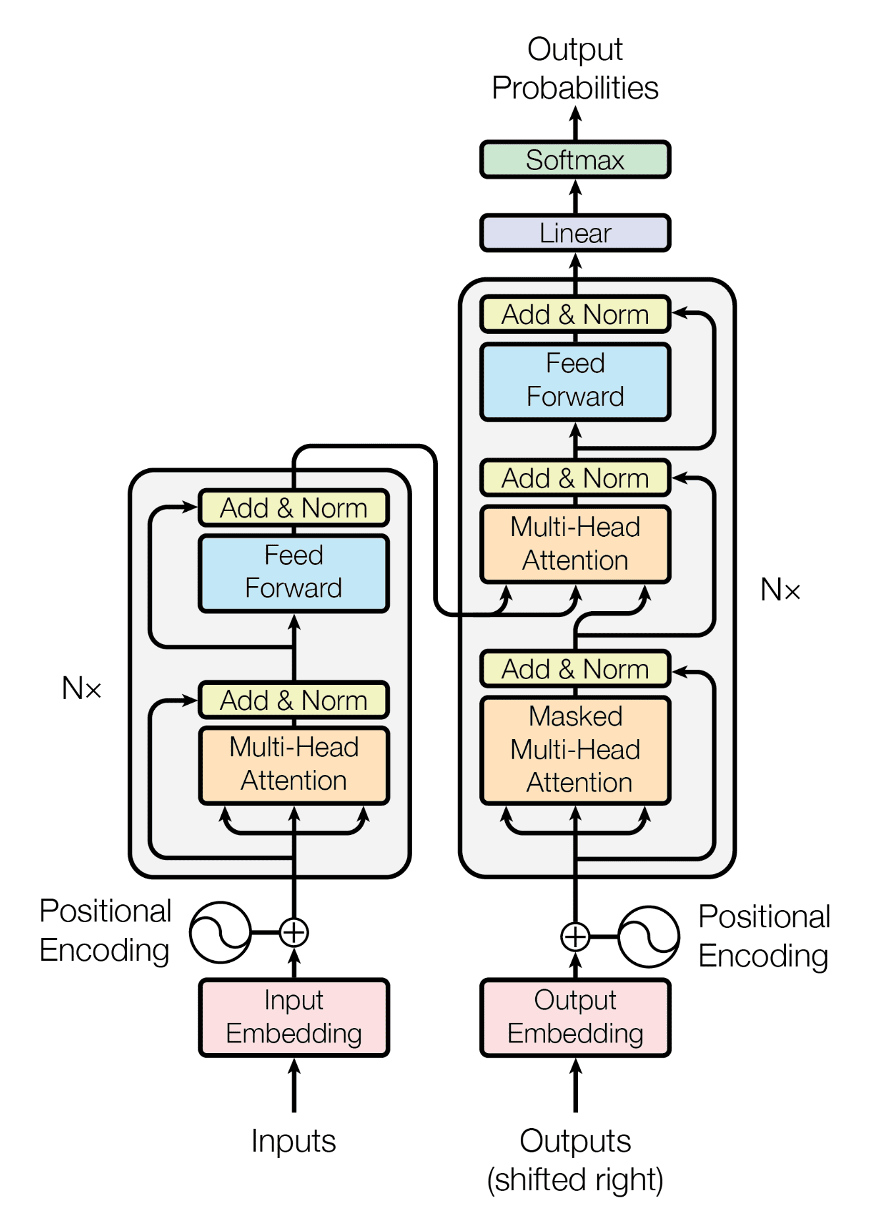
Fig 4.1
Transformer Architecture

Slide 18
Model Architecture
1. Input Projection: Maps input features to Transformer dimensions.
2. Transformer Encoder: Captures temporal dependencies.
3. Multi-Head Attention:
- Daily Attention
- Weekly Attention
4. MLP: Combines features and refines predictions.
5. Output Layers: Fully connected layers

Slide 19
Results
Region | Train RMSE | Validation RMSE | Train Loss | Val Loss | Test RMSE | Test Loss | Epochs
Kanpur | 0.0336 | 0.0367 | 0.0012 | 0.0018 | 0.0257 | 0.0009 | 76
Delhi | 0.0440 | 0.0439 | 0.0020 | 0.0021 | 0.0410 | 0.0023 | 31
kangra | 0.0289 | 0.0358 | 0.0009 | 0.0015 | 0.0419 | 0.0020 | 77
Table 4.1(Train and validation result over epochs)

Slide 20
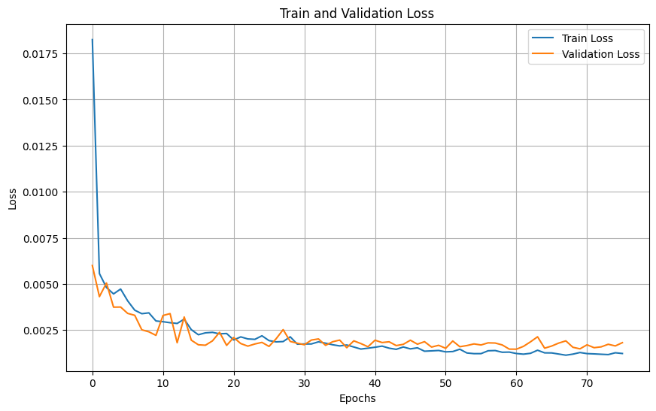
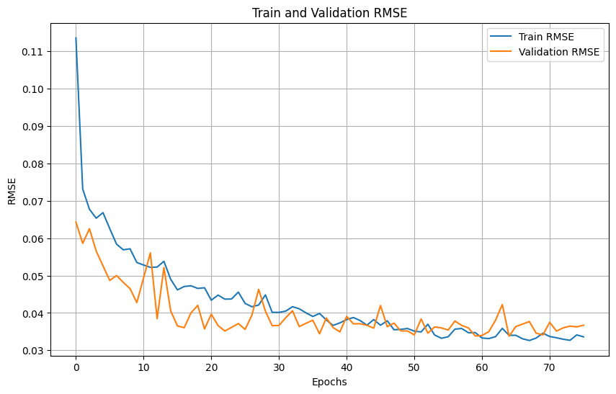
Fig 4.1
Kanpur Region

Slide 21
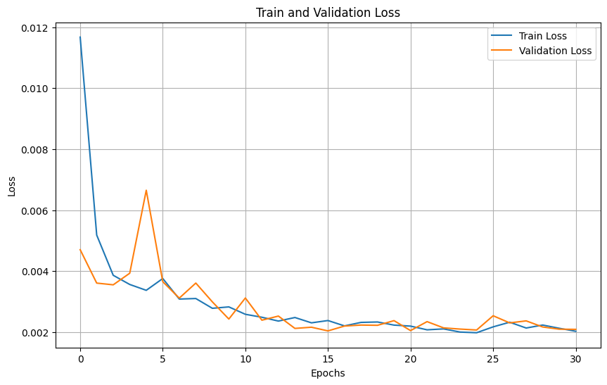
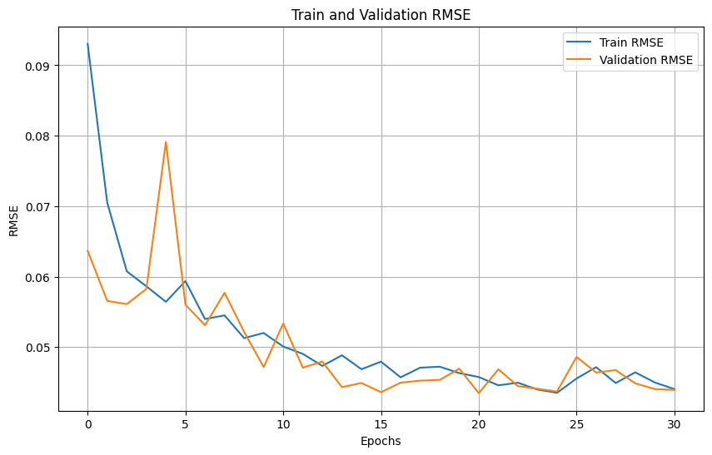
Delhi Region
Fig.4.2(Train and test result over epochs )

Slide 22
Model 2-LSTM+Attention
Architecture:Sequence-to-sequence (Seq2Seq) model with attention.
Components:Encoder:LSTM processes input sequences and produces hidden states.
Decoder:LSTM generates predictions based on encoder outputs.
Attention Mechanism:Focuses on relevant parts of the input sequence for better predictions.

Slide 23
LSTM+ATTENTION MODEL
Input: Feature sequences (e.g., temperature, rainfall, humidity).
Encoder: LSTM layer with hidden states.
Attention Mechanism: Context vector derived from encoder and decoder.
Decoder: LSTM with Dense layers to predict soil moisture

Slide 24
Results
Region | Train RMSE | Validation RMSE | Train Loss | Val Loss | Test RMSE | Test Loss | Epochs
Delhi | 0.0721 | 0.0277 | 0.0128 | 0.0017 | . 0.0243 | 0.0006 | 18
Table 4.2(Train and test result over
LSTM +ATTENTION MODEL)

Slide 25
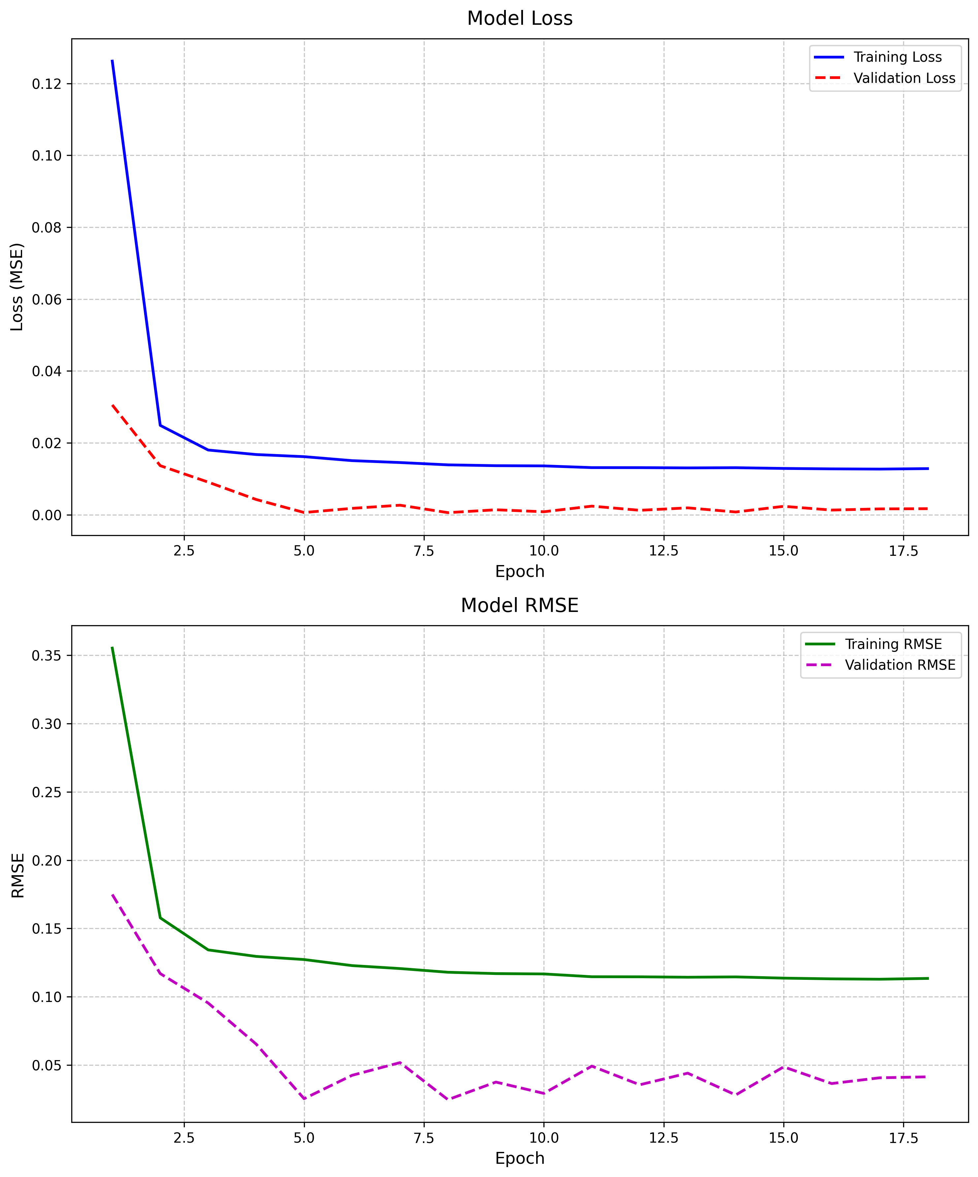
Results
Fig 4.4

Slide 26
MODEL 3-LSTM+MAML
Data Loading and Preprocessing
LSTM Model Architecture
MAML Implementation
Training Loop
Evaluation and Visualization

Slide 27
Model Architecture
Data Preprocessing : Clean the data Handle missing values
Input format: - Rainfall, Temperature, Humidity, Soil Moisture
Output format:
X: Sequence of previous days of features
y: Next day's soil moisture

Slide 28
Model Architecture
Two LSTM layers : LSTM1: Basic pattern recognition
LSTM2: Higher-level patterns
MAML process:
Base Model
Region Adaptation(Inner loop)
Evaluation
Model Update

Slide 29
Model Architecture
For each region (Kanpur, Delhi):
Inner Loop:
Quick adaptation
Divide the data in source set
Outer Loop:
Update base model
Divide the model in to query set
Evaluate the adapted model on the query set (e.g., Kanpur’s
query set).

Slide 30
End to End work flow
Tasks (regions): Kanpur, Delhi, and Ludhiana.
Each task has:
Support Set: Used for task-specific adaptation.
Query Set: Used for evaluating the adaptation.
Meta-Model Initialization:
Start with a general meta-model (θ) shared across all tasks.

Slide 31
End to End work flow
Inner Loop (Task-Specific Adaptation for Kanpur):
Take the support set for Kanpur (e.g., Days 1–70).
Fine-tune the meta-model on this support set:
Use the meta-model to make predictions on Kanpur's support set.
Compute the task-specific loss (e.g., MSE Loss).
Update the model parameters using gradient descent (a small number of steps).

Slide 32
End to End work flow
Outer Loop (Evaluate on Query Set):
Evaluate the adapted model on Kanpur’s query set (Days 71–100).
Compute the meta-loss for the query set.
Update Meta-Model:
Aggregate meta-losses across all tasks (e.g., Kanpur, Delhi).
Use the aggregated meta-loss to update the meta-model parameters (θ)
Repeat for Other Tasks (Delhi):
Perform the same inner loop and outer loop for each task

Slide 33
Training process summary
Aspect | Details
Data Splits | 80% training (split into support/query), 10% validation, 10% test.
Epochs and Patience | 300 epochs with early stopping (patience: 20 epochs).
Key Hyperparameters | Learning rates (0.01 inner, 0.001 meta), batch size (64), dropout (0.3), hidden size (128).
Overfitting Solution | Dropout, early stopping, and weight decay.
Vanishing Gradients | Gradient clipping and attention mechanism.
Optimizers | Adam (inner loop), AdamW with scheduler (outer loop).
Meta-Loss Behavior | Rapid initial decrease, plateau, and stabilization with a learning rate scheduler.

Slide 34
Results
Region | Test RMSE | Test Loss | Epochs
kangra | 0.2750 | 0.004015 | 24
Table 4.4

Slide 35
05
References

Slide 36
References
J. Smith, A. Doe, and T. Brown, "A hybrid CNN-GRU model for predicting soil moisture in maize root zone," Journal of Agricultural Data Science, vol. 15, no. 4, pp. 345-360, 2022. doi: 10.1016/j.jads.2022.05.010
A. Singh and P. Sharma, "Smart Irrigation System Based on IoT and Machine Learning," International Journal of Agricultural Technology, vol. 12, no. 3, pp. 150-160, 2021. doi: 10.1016/j.agritech.2021.04.005
M. Johnson, R. Lee, and K. Patel, "Deep Learning Methods and Applications for Precision Agriculture," Computers and Electronics in Agriculture, vol. 180, pp. 105-117, 2021. doi: 10.1016/j.compag.2021.105117

Slide 37
Refrences
Sushil kumar,, P. Rahtee, and R. Verma, "Towards Precision Agriculture: IoT-Enabled Intelligent Irrigation Systems Using Deep Learning Neural Network," International Journal of Precision Agriculture, vol. 28, no. 2, pp. 215-230, 2023. doi: 10.1016/j.ijpa.2023.05.012

Slide 38
Thank You

